Slide 1
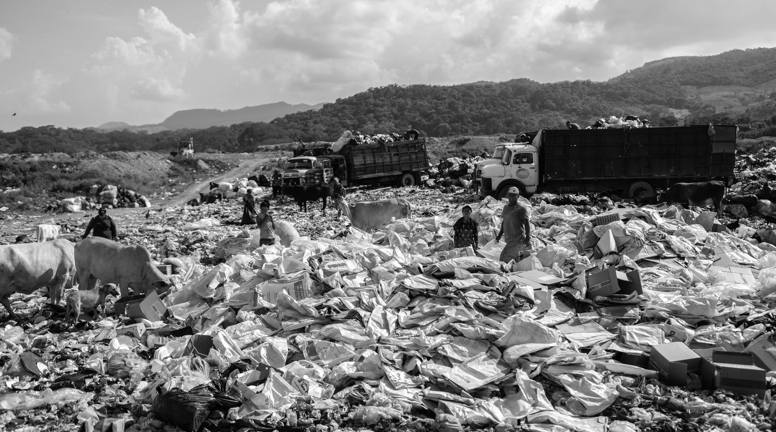
SUSTAINABILITY
WITH A SOUL

Slide 2
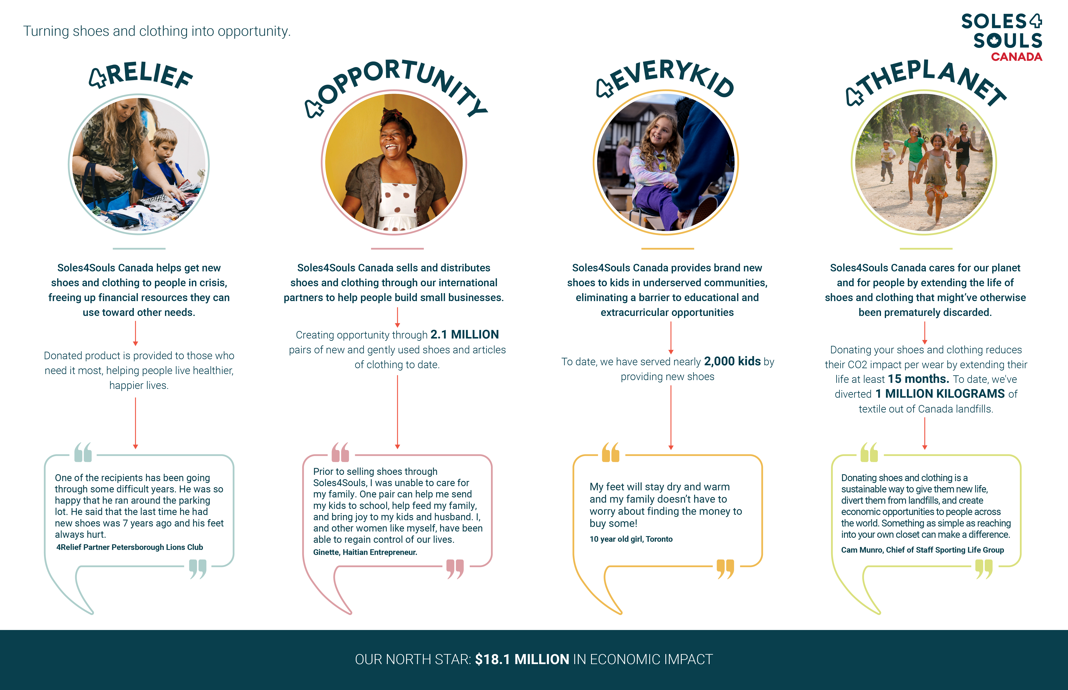

Slide 3
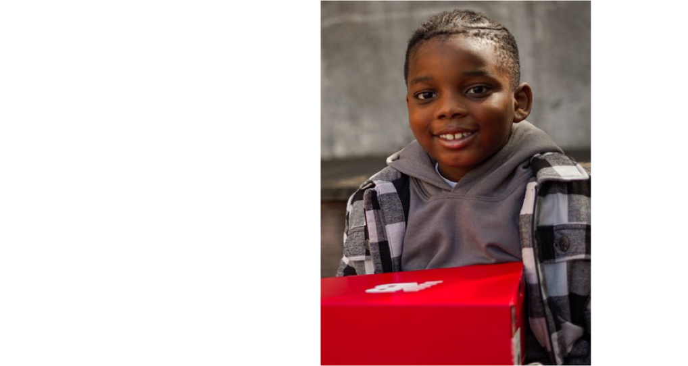
Mission Statement
Soles4Souls Canada
When people lack the resources to get through today, it’s difficult for them to focus on tomorrow.
Soles4Souls Canada turns shoes and clothing into opportunities for education and employment so they can have a more hopeful future.

Slide 4
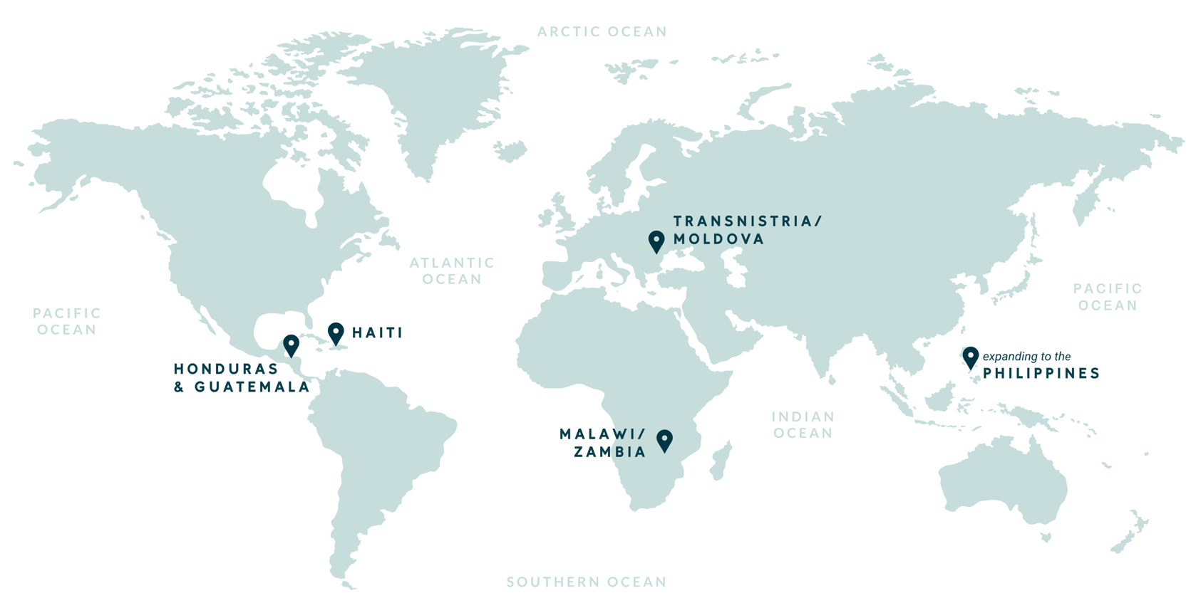
WORKING WORLDWIDE TO PROVIDE OPPORTUNITY
THROUGH SHOES AND CLOTHING.
Together, with your support, Soles4Souls Canada has provided more than
2.5 million pairs of shoes and pieces of clothing to people in need around the world.

Slide 5
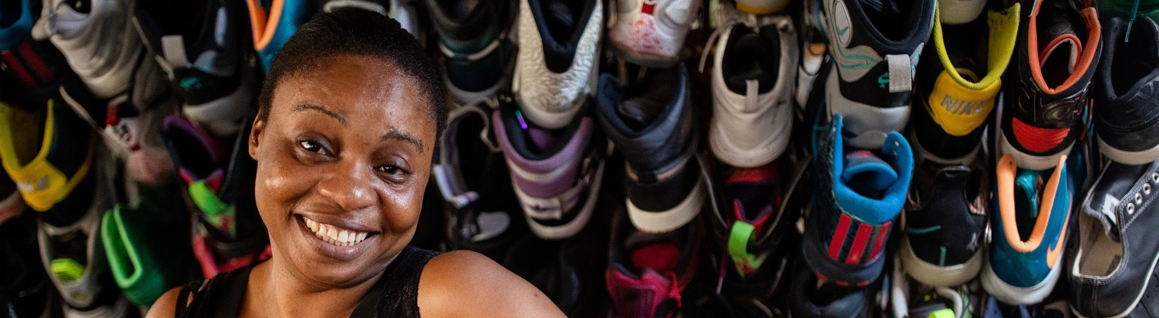
4Opportunity
Soles4Souls Canada sells and distributes shoes and clothing through our international partners to help people build small businesses. Selling shoes creates small businesses and jobs in low-income countries.
Those businesses and jobs help provide food, education, and shelter for entrepreneurs, employees, and their families.
Entrepreneurs have been able to increase their household income by more than 200%, that’s more than 5 times above the international poverty line.
Soles4Souls ships donations to vetted international organizations who purchase the shoes and clothing for a nominal fee. That money helps fund our 4Relief and 4EveryKid programs.
Entrepreneurs and thrift store owners resell the inventory at a markup that both allows them to earn a sufficient income and gives people in their community access to afford shoes and clothing.
Individuals donate gently used shoes, and brands donate excess or returned shoes and clothing. Soles4Souls sorts the donations.
Vetted organizations sell the inventory to entrepreneurs and thrift stores at a a modest markup.

Slide 6
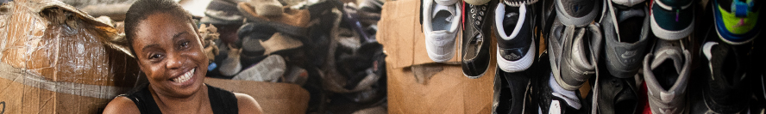
4Opportunity: Headline Impact
Thanks to supporters like you, who believe along with us, that given the opportunity, a person can change the trajectory of their lives and break the cycle of poverty. The proof is in our numbers – shoes can do just that.
98% of entrepreneurs share they have increased confidence in themselves, their ability to run a business, and inspire and care for their family and friends. 100% are more optimistic for the future.
Increased household income by 233%
1 in 4 entrepreneurs purchased their home through selling S4S shoes.
87% Improved quality education and regular attendance for their children.
By donating your gently used shoes, you’re increasing the lifespan of your shoes by
15+ months!

Slide 7

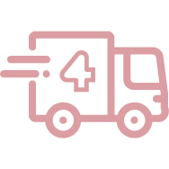


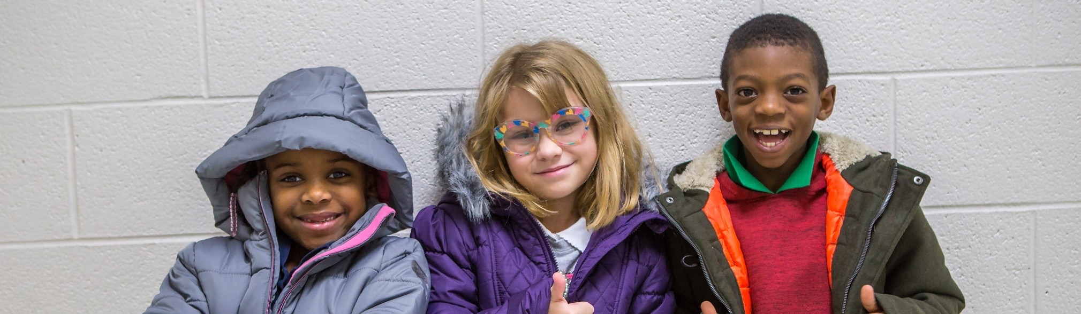
4Relief
Soles4Souls Canada helps get new shoes and clothing to people in crisis, freeing up financial resources they can use toward other needs.
Together with our partners, we lend a hand to people and communities in need – right when they need it.
S4S Canada procures new product donations from retailers and manufacturer.
Product is sent to S4S Canada for processing, then sorted and made ready for distribution.
We work with over 250 partners, such as shelters, churches, and relief organizations to provide shoes and clothing.
Donated product is provided to those who need it most, helping people live healthier, happier lives.

Slide 8

4Relief: Impact
When people experience economic hardship – either chronically or because of a crisis – meeting basic needs is a challenge. Together, with over 250 partners throughout Canada, we get new shoes and clothing to people in crisis, freeing up financial resources they can use toward other needs.
NEW SHOES IMPACT
4 in 5 saw improved health
2 in 3 said they didn’t have adequate clothing before receiving new clothing from Soles4Souls
33% saw a reduction in homelessness and poverty
Help 1 in 2 recipients return to work
One of the recipients has been going through some difficult years. He was so happy that he ran around the parking lot. He said that the last time he had new shoes was 7 years ago and his feet always hurt.
- 4Relief Partner
Peterborough Lions Club - Canada

Slide 9
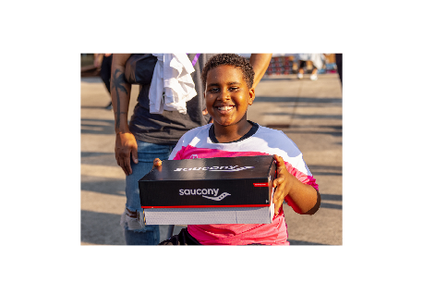
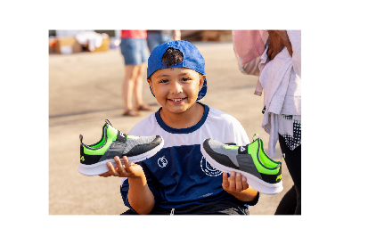
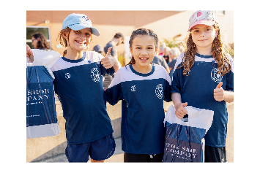
4EveryKid
S4S Canada partners with schools across Canada to get new athletic shoes to kids in underserved communities, eliminating a barrier to educational and extracurricular opportunities.
More than 1 in 8 children are living in poverty in Canada.
DISPROPORTIONATE IMPACT
Communities of color, indigenous, and LGBTQ are much more likely to experience homelessness.
*Per HOMELESS HUB (https://www.homelesshub.ca/)

Slide 10
4EveryKid: Headline Impact
We believe in giving a hand up, not a handout. Research shows that shoes not only have a physical impact on a kid’s
well-being, but an emotional and psychological impact as well.
By giving a child a new pair of shoes, you’re meeting the need for comfort, but also giving them confidence, dignity,
and happiness.
2 in 3 improved grades
98% of students said they felt more confident in their new shoes.
12% of students needed and utilized their shoes for employment.
4 in 5 said they feel more equal to their peers.
3 in 4 increased participation in sports/extracurriculars
To date, we have served nearly 2,000 kids by providing new shoes.
New shoes provide confidence, hope, and dignity for a child in need.

Slide 11
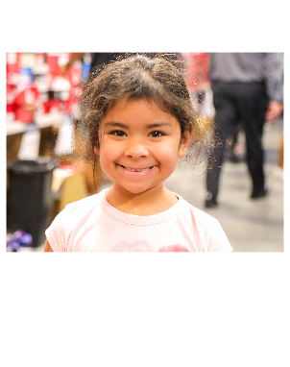
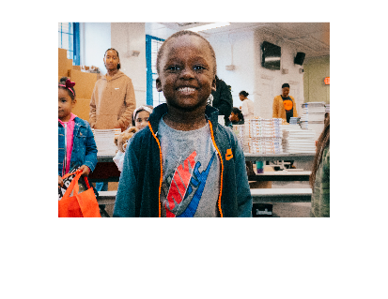


4EveryKid
My feet will stay dry and warm and my family doesn’t have to worry about finding the money to buy some
- 10 year old girl
These shoes make me feel good and make me more comfortable when playing basketball.
- 13 year old boy
It’s been a good 3 years since I’ve gotten new shoes. These are clean!
- 14 year old male

Slide 12
4thePlanet
By repurposing unwanted items and putting them to good use, we find them a new home and extend their lifespan.
Together with our supporters, more than 2.5 million pairs of shoes and pieces of clothing have helped create opportunities for people across the world.
DIVERT FROM LANDFILL
UNIQUE TAKE ON
“CIRCULARITY”
LOCATION,LOCATION, LOCATION
TOGETHER, WE GO
FURTHER
We are able to repurpose nearly 99% of shoes we receive.
At S4S Canada, we are creating a wider circle so that everyone has access to a better life and cleaner planet.
Our warehouses are strategically situated across Canada, US, Europe and Asia in efforts to reduce our carbon footprint.
S4S Canada works with brand partners to create innovative takeback initiatives that create win-win opportunities to maximize product use.
Notes:
Pull from S4S ca talking points “since 2006 together w/ supporters”

Slide 13
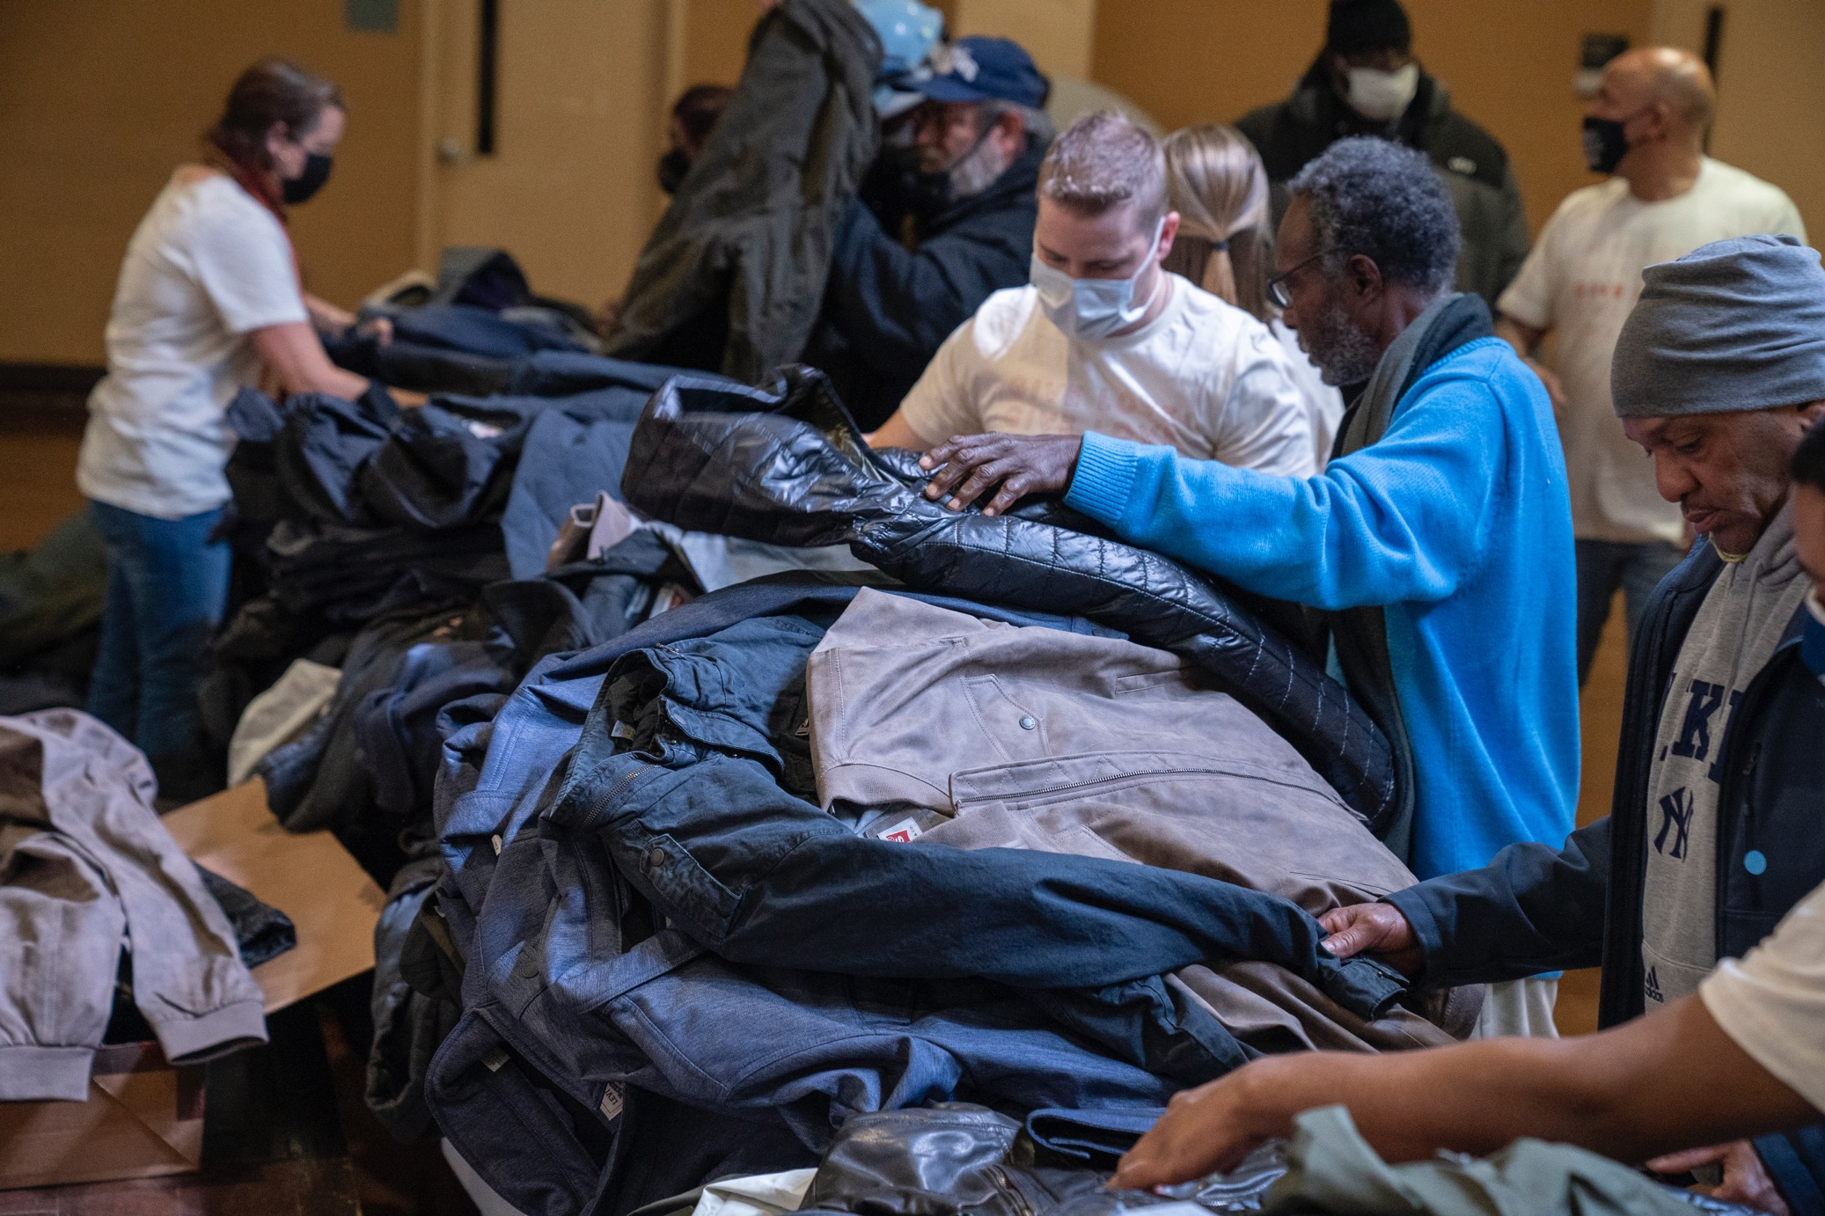






PARTNER WITH US
DONATE INVENTORY
Alleviate excess inventory, returns, or defective product to promote sustainability.
EMPLOYEE GIVING
Invite your employees to collect shoes, host a fundraiser, or get involved through one of our volunteer opportunities.
POINT OF SALE
Ask customers to support S4S at check out and/or online, whether through a flat donation or round up.
TRADE-IN EVENT
Encourage customers to bring in a used pair of shoes to receive a discount on their next purchase.
CORPORATE MATCH
Encourage your employees to give back by providing a match for each dollar they donate.
PERCENT OF PURCHASE
Designate a percentage of sales or donate $20 to S4S each time a specific product is purchased.

Slide 14















Just a few of
our partners

Slide 15
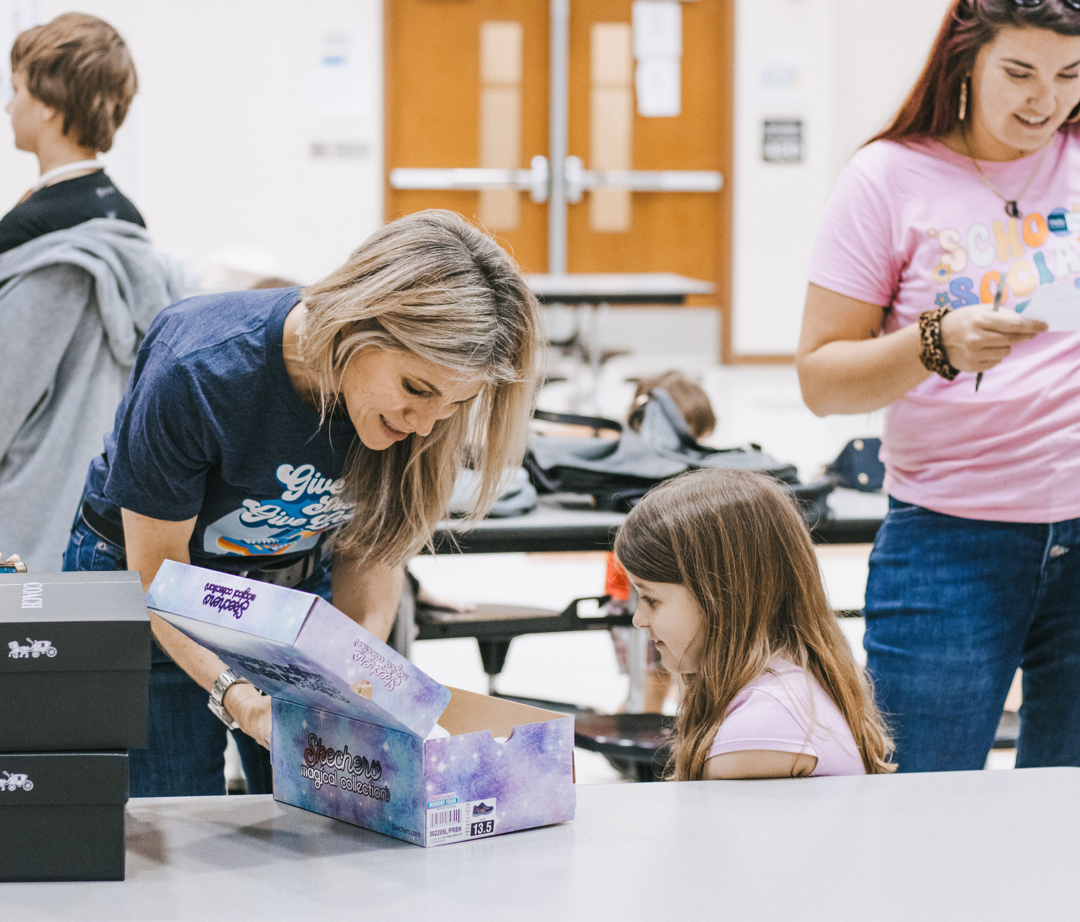
Appendix
About Us: https://www.soles4soulscanada.org/about-us/
Partnership: https://soles4soulscanada.org/brand-partnerships/
Volunteering: https://www.soles4soulscanada.org/volunteer/
Shoe Drives: https://soles4soulscanada.org/shoe-drive/
Resources: https://www.soles4soulscanada.org/resources/

Slide 16
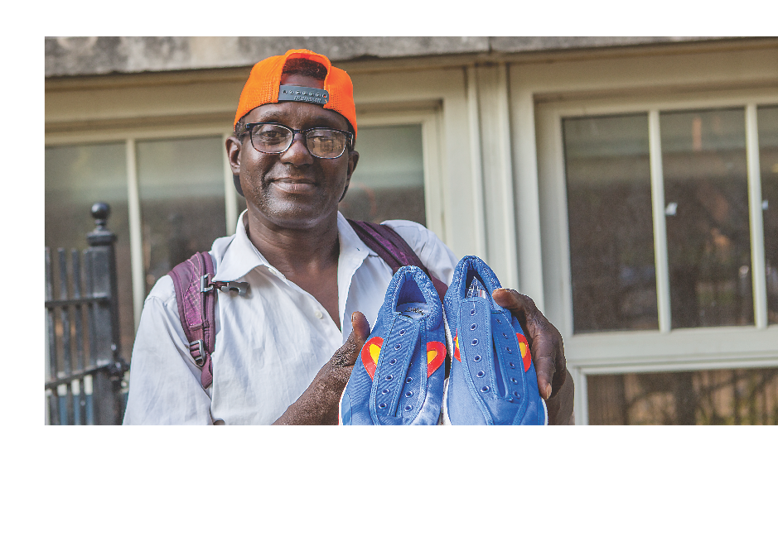



THANK YOU
Questions? Contact: marias@soles4souls.org
Follow us on social: @Soles4SoulsCanada
Notes:
Include links to socials / email contact: corporate@soles4souls.org
PDF = linkable links – videos, website, impact calculator
PDF = no video embedded

